Slide 1
Performance evaluation of blended coconut oil and fish oil on growth performance and response to Streptococcus iniae challenge on Nile Tilapia (Oreochromis niloticus)
Andrews Apraku, Xiangjun Leng, Emmanuel J. Rupia, Christian L. Ayisi
Shanghai Ocean University
Speaker: Liping Liu

Slide 2
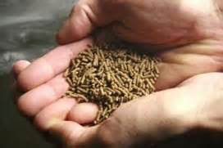
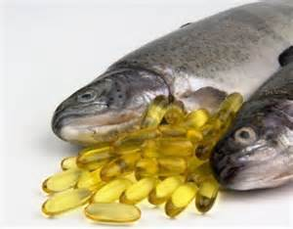
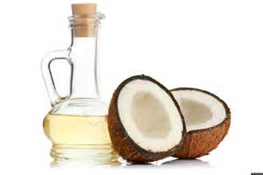
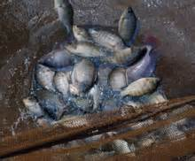
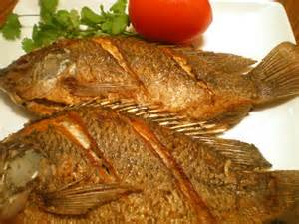
Contents
Introduction
Objectives
Materials and methods
Results
Discussion
Conclusion

Slide 3
Introduction
Alternative sources
sxlnkcnakcn
~8.9MT -2020
Nutrition >50%
85% FO produced
Meeting demand
Low production
overfishing
Plants / vegetables
High cost
Diseases
Antibiotics ban
Naylor et al., 2000; FAO,2007,2014,2010; Tacon, 1993, Venega-calerion et al., 2010; De-silva et al., 2004
Notes:
This sector alone is reported to consume approximately 88.5% (835,000 tons) of the total fish oil produced in 2006 and this is expected to increase as the industry grows. the higher demand for fish oil has endangered some fish species (herring, sardine, anchovy, capelina, etc) which are considered to have low economic value/high ecology value and less for human consumption used in the production of the oil as they have been overexploited

Slide 4
Coconut oil
Accounts for 20% of world vegetable oil - [CRB Fundamentals, 2008]
High SFA’S,92%; Low MSFA and PUFA of 6% and 2% respectively- [Applewhite, 1994]
C10:0 and C18:0 act as energetic substrate – [Benevenga, 1989; Alice et al., 2006].
Higher lauric acid- antibacterial, antiprotozoal and antiviral properties – [Ogbolu et al., 2007]
High resistance to oxidative reaction
Stable under warm temperatures (stable) – [Alice et al., 2006]
Notes:
Medium chain fatty acid

Slide 5
Coconut oil
C12 is absorbed easily - [Olsen et al., 1993]
Improve LC-PUFA retention and restoration in feeds – [Trusheuski et al., 2008, 2009]
It gives diet flavor – [Bozzolo et al., 1993]
price: 29 cents per pounds in 2006 – [CRB Fundamentals, 2008]
- [US Department of Agriculture, 2011]
Year | 2005-06 | 2006-07 | 2007-8 | 2008-09 | 2009-10 | 2010-11
Production/ Million tonnes | 5.91 | 5.42 | 5.79 | 5.62 | 6.60 | 6.24

Slide 6
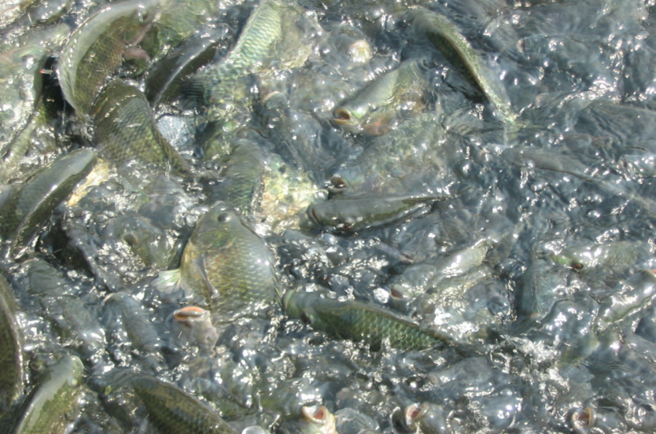
Objectives
Evaluate the effect on dietary levels on growth performance and feed utilization
Evaluate the effects of dietary lipid levels on body composition and fatty acid profile of Nile tilapia, Oreochromis niloticus
Evaluate the effects of dietary lipid levels on blood metabolites of Nile tilapia, Oreochromis niloticus

Slide 7
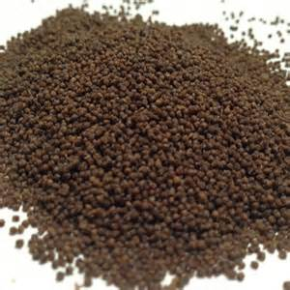
Materials and methods
Table 1: Proximate composition of ingredients (%DM) in experimental diets with different added lipid sources.
Ingredients (g 100g⁻¹) | Experimental groups
 | Diet A | Diet B | Diet C | Diet D | Diet E
Fish meal | 10.00 | 10.00 | 10.00 | 10.00 | 10.00
Soybean meal | 20.00 | 20.00 | 20.00 | 20.00 | 20.00
Wheat bran | 20.00 | 20.00 | 20.00 | 20.00 | 20.00
Rape seed meal | 24.26 | 24.26 | 24.26 | 24.26 | 24.26
Wheat Middling | 20.00 | 20.00 | 20.00 | 20.00 | 20.00
Fish oil (FO) | 3.00 | 2.25 | 1.50 | 0.75 | 0.00
Virgin coconut oil (VCO) | 0.00 | 0.75 | 1.50 | 2.25 | 3.00
Vitamin and Mineral mix | 0.65 | 0.65 | 0.65 | 0.65 | 0.65
Vitamin C | 0.05 | 0.05 | 0.05 | 0.05 | 0.05
Choline Chloride | 0.50 | 0.50 | 0.50 | 0.50 | 0.50
Inositol | 0.04 | 0.04 | 0.04 | 0.04 | 0.04
Ca(H₂PO₄) | 1.50 | 1.50 | 1.50 | 1.50 | 1.50
Total | 100.00 | 100.00 | 100.00 | 100.00 | 100.00
FO/VCO=100%(Diet A), 3:1 (Diet B), 1:1 (Diet C), 1:3(Diet D), 0%(Diet E).
Notes:
Lipid combination

Slide 8
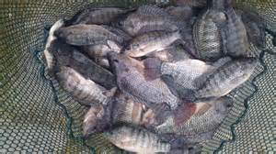
Materials and methods Feeding trial
750 fingerlings
2weeks acclimation
5 groups
2/day feeding
8 weeks

Slide 9
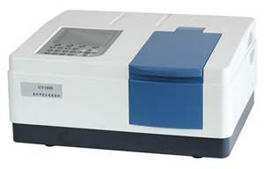
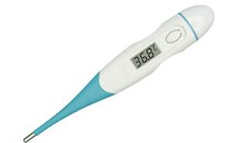
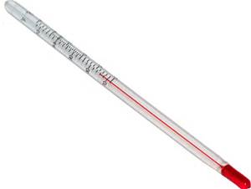
Materials and methods
Measurements
Weight and length: 15 fish/15th day
Termination point: All experimental fish
Feed: amount fed to fish calculated daily
Ammonia and nitrite measured as well on weekly basis - [APHA, 1998]
Dissolved oxygen (DO) concentration, pH, and water temperature monitored on daily basis with appropriate instrument and methods.

Slide 10
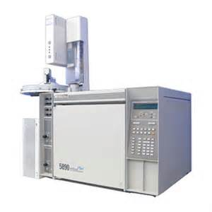
Materials and methods Sampling and analytical methods
Whole body proximate analysis
15 fish
- initial
15fish /group
Moisture
Lipid
Ash
protein
Fatty acid
LIVER
MUSCLE
WHOLE BODY
FEED
Plasma metabolites
Blood serum
Cholesterol
TP, TG
(BS 2000)
[AOAC, 1995]
[Folch et al., 1957]

Slide 11
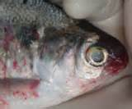
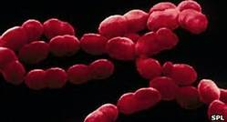
Materials and methods Bacteria challenge
S. iniae (ARS 98-60)
0.1mL of 1x10⁶ CFU/mL
16 days monitoring
IP / 30 fish/group
[Yildrim et al., 2003]

Slide 12
Data analysis and statistics
SGR (%) = (ln final weight – ln initial weight / number of days *100
WG (%) = (final body weight – initial body weight / initial body weight) * 100
K = Body weight (g) / total length (cm)³ *100
FCR = Feed intake (g) / Weight gain (g)
FI = Total feed consumed (g) during the 56 days trial.
SR = Total number of fish stocked / Total number at the end of the feeding trial

Slide 13
Data analysis and statistics
FCR = 100 ((ln initial fat content of fish – ln final fat content of fish)/ T
PER = Weight gain (g) / Protein intake (g)
HSI = Liver weight (g) / Whole body weight (g) * 100
Data was analysed by one-way analysis of Variance (ANOVA) to test the effects of the five experimental diets.
Statistical analysis was made using graph Pad prism 5.1 .
All data were presented as mean ± SEM.

Slide 14
Results
FATTY ACID(S)
 | Diet A | Diet B | Diet C | Diet D | Diet E
12:0 | 0.23±0.04ª | 5.51±2.79^{ab} | 14.87±0.41^{bc} | 19.64±0.36^{c} | 20.97±5.60^{c}
14:0 | 3.63±0.13ª | 5.56±0.23^{ab} | 6.84±0.04^{ab} | 8.31±0.05^{b} | 8.65±1.10^{b}
Total SFA’s | 21.90±8.12 | 25.64±4.54 | 38.01±2.70 | 49.37±1.51 | 53.17±9.37
18:1(n-9) | 19.98±7.53 | 19.11±6.26 | 21.65±0.70 | 13.91±4.50 | 10.71±3.92
TOTAL | 38.42±13.99 | 37.65±13.50 | 30.60±1.18 | 25.44±9.59 | 21.62±10.58
MUFAs
18:2(n-6) | 25.22±2.38 | 25.96±0.81 | 24.14±0.76 | 20.87±0.26 | 23.12±5.01
20:4(n-6)ARA | 0.49±0.06ª | 0.19±0.10^{ab} | 0.16±0.08^{b} | 0.11±0.03^{b} | 0.04±0.02^{b}
Total n-6 | 25.73±2.45 | 26.15±0.91 | 24.34±0.86 | 20.98±0.29 | 23.16±5.03
18:3(n-3) | 0.46±0.12ª | 0.27±0.03^{ab} | 0.27±0.06^{ab} | 0.27±0.05^{ab} | 0.11±0.05^{b}
20:5(n-3)EPA | 4.18±0.40ª | 3.56±0.07ª | 2.40±0.05^{c} | 1.57±0.05^{b} | 0.85±0.01^{b}
22:6(n-3)DHA | 7.35±0.81^{b} | 5.22±0.17^{b} | 3.35±0.07^{b} | 1.87±0.07ª | 0.87±0.06ª
Total n-3 | 13.25±1.87ª | 10.19±0.75^{b} | 6.45±0.22^{c} | 3.98±0.18^{d} | 1.98±0.16e
Total PUFAs | 39.13±4.37^{b} | 36.46±1.72^{b} | 30.92±1.09^{b} | 25.07±0.48ª | 25.21±5.20ª
Total LC-PUFAs | 12.53±1.73ª | 9.63±0.76^{b} | 6.34±0.24^{c} | 3.82±0.16^{d} | 1.87±0.10e
Total MC-PUFAs | 26.45±2.60ª | 26.71±0.90ª | 24.45±0.84^{b} | 21.14±0.31^{c} | 23.27±5.19^{b}
n-3:n-6 | 0.52±0.76ª | 0.39±0.82^{ab} | 0.27±0.26^{bc} | 0.19±0.62^{cd} | 0.09±0.03^{d}
Fatty acid (FA) composition (% total FA) of experimental diets
Notes:
1inoleic acid C18：3，n-3,lauric acid c12:0

Slide 15
Results

Slide 16
Results

Slide 17
Results
Major nutrient composition of moisture, crude lipid, protein and ash content of whole body and muscle of Nile tilapia fed different diets for 8 weeks
 |  | Diet A | Diet B |  | Diet C |  | Diet D | Diet E
Initial whole body |  | Final whole body
Moisture | 10.75±1.20 | 11.40±1.45 | 11.21±0.90 |  | 11.18±1.20 |  | 11.07±0.31 | 11.09±0.58
Protein | 63.30±1.42 | 58.40±0.87 | 59.69±0.33 |  | 61.00±1.60 |  | 62.61±2.46 | 64.06±1.48
Lipid | 7.04±0.32^{bc} | 2.74±0.90ª | 3.26±0.33ª |  | 4.67±0.59^{ab} |  | 7.44±0.36^{c} | 6.62±0.15^{bc}
Ash | 0.28±0.00^{d} | 0.80±0.01ª | 0.73±0.01^{b} |  | 0.72±0.00^{b} |  | 0.78±001^{ac} | 0.72±0.01^{bc}
MUSCLE
Moisture |  | 10.45±0.15ª | 10.52±0.86ª | 10.42±0.48ª |  | 10.69±0.18^{ab} |  | 10.90±0.90^{b}
Protein |  | 94.33±0.41ª | 95.85±0.20^{ab} | 96.47±0.32^{b} |  | 95.63±0.60^{ab} |  | 96.48±0.26^{b}
Lipid |  | 2.22±0.22ª | 1.77±0.18^{ab} | 1.15±0.04^{bc} |  | 1.07±0.17^{bc} |  | 0.90±0.13^{c}
Ash |  | 0.28±0.00^{ab} | 0.26±0.00^{ab} | 0.27±0.00^{ab} |  | 0.25±0.02ª |  | 0.29±0.00^{b}

Slide 18
Results
Fatty acid (%area) of whole body of tilapia fed diets of elevated VCO levels for 8 weeks
FATTY ACID(S)
 | Diet A | Diet B | Diet C | Diet D | Diet E
12:0 | 0.000±0.00^{c} | 2.40±0.07^{b} | 5.27±0.46^{b} | 7.39±0.59ª | 8.93±0.65ª
14:0 | 3.68±0.07ª | 4.18±0.43ª | 6.44±0.31^{c} | 7.61±0.35^{b} | 8.67±0.31^{b}
Total SFA’s | 38.59±0.46ª | 39.64±0.83ª | 44.61±1.62^{b} | 46.14±1.87^{b} | 48.61±1.74^{b}
18:1(n-9) | 30.60±0.32ª | 30.02±0.35^{ab} | 28.79±0.73^{abc} | 27.64±0.43^{c} | 26.91±0.47^{bc}
TOTAL MUFAs | 41.89±2.91^{b} | 39.68±0.51^{b} | 39.00±1.25^{b} | 36.30±1.42ª | 35.35±1.67ª
18:2(n-6) | 16.11±0.39^{ab} | 18.25±0.20ª | 15.22±1.00^{ab} | 16.40±0.90^{ab} | 14.39±0.59^{b}
20:4(n-6)ARA | 0.11±0.06 | 0.17±0.06 | 0.14±0.05 | 0.08±0.05 | 0.16±0.14
Total n-6 | 16.22±0.45 | 18.42±0.26 | 15.39±1.08 | 16.48±0.95 | 14.55±0.73
18:3(n-3) | 0.27±0.12 | 0.12±0.02 | 0.19±0.06 | 0.18±0.04 | 0.11±0.09
20:5(n-3)EPA | 0.13±0.10 | 0.10±0.02 | 0.12±0.08 | 0.18±0.05 | 0.13±0.05
22:6(n-3)DHA | 2.03±0.06^{b} | 1.28±0.03^{b} | 0.94±0.03^{b} | 0.50±0.06ª | 0.40±0.03ª
Total n-3 | 3.17±0.55^{c} | 2.18±0.32ª | 1.66±0.11^{ab} | 1.01±0.22^{b} | 1.04±0.34^{b}
Total PUFAs | 19.39±1.0ª | 20.60±0.58ª | 17.05±1.19^{b} | 17.49±1.17^{b} | 15.59±1.07^{c}
Total LC-PUFAs | 2.91±0.39ª | 1.96±0.23^{ab} | 1.58±0.19^{ab} | 0.85±0.19^{b} | 0.99±0.33^{b}
Total MC-PUFAs | 16.48±0.55ª | 18.64±0.35^{c} | 15.47±1.09^{ab} | 16.64±0.98ª | 14.60±0.74^{b}
n-3:n-6 | 0.20±1.22ª | 0.12±1.23^{ab} | 0.12±0.10^{ab} | 0.06±0.23^{b} | 0.07±0.47^{b}

Slide 19
Results
Fatty acid composition of muscle (% area) of tilapia fed different diets for 8 weeks
FATTY ACID(S)
 | Diet A | Diet B | Diet C | Diet D | Diet E
12:0 | 0.00±0.00ª | 1.44±0.43^{ab} | 2.81±0.05^{ab} | 6.03±1.28^{bc} | 7.61±1.86^{c}
14:0 | 2.48±0.14ª | 2.70±0.19ª | 3.97±0.37^{ab} | 4.78±1.09^{ab} | 6.26±1.11^{b}
Total SFA’s | 40.56±1.36ª | 46.27±1.90^{ab} | 52.33±1.46^{bc} | 50.00±4.07^{bc} | 53.20±4.80^{c}
18:1(n-9) | 22.71±0.68^{ab} | 22.00±0.28^{ab} | 21.65±0.18^{ab} | 23.24±0.77ª | 20.93±0.25^{b}
TOTAL MUFAs | 31.86±1.82^{abc} | 29.15±0.61ª | 29.06±0.85^{b} | 30.11±1.69^{c} | 27.99±0.62^{c}
18:2(n-6) | 13.31±0.15^{ab} | 14.81±0.71^{b} | 10.92±0.14ª | 13.90±0.60^{b} | 13.24±0.70^{ab}
20:4(n-6)ARA | 1.93±0.33 | 1.37±0.30 | 1.08±0.17 | 1.52±0.62 | 0.11±0.23
Total n-6 | 15.47±0.62 | 16.18±1.01 | 12.00±0.31 | 15.42±1.22 | 13.35±0.93
18:3(n-3) | 0.15±0.06 | 0.18±0.13 | 0.16±0.09 | 0.55±0.14 | 0.37±0.03
20:5(n-3)EPA | 0.06±0.06 | 0.02±0.02 | 0.03±0.02 | 0.06±0.03 | 0.08±0.01
22:5(n-3) | 1.52±0.65^{b} | 0.00±0.00ª | 0.00±0.00ª | 0.00±0.00ª | 0.00±0.00ª
22:6(n-3)DHA | 9.02±0.14^{d} | 6.53±0.23ª | 5.04±0.69^{ab} | 2.31±0.38^{c} | 3.14±0.54^{bc}
Total n-3 | 12.37±1.34^{b} | 8.05±0.61^{b} | 6.55±1.01^{b} | 3.42±0.82ª | 4.42±0.70ª
Total PUFAs | 27.84±1.96^{b} | 24.23±1.62^{b} | 18.55±1.32ª | 18.84±2.04ª | 17.77±1.63ª
Total LC-PUFAs | 14.38±1.75^{b} | 9.24±0.78^{b} | 7.47±1.09^{b} | 4.39±1.30ª | 4.16±0.90ª
Total MC-PUFAs | 13.46±0.21ª | 14.99±0.84ª | 11.08±0.23^{b} | 14.45±0.74ª | 13.61±0.73ª
n-3:n-6 | 0.70±2.16^{c} | 0.50±0.60ª | 0.55±3.26ª | 0.22±0.67^{b} | 0.33±0.75^{b}

Slide 20
Results
Liver fatty acid composition of O. niloticus fed elevated levels VCO for 8 weeks
FATTY ACID(S)
 | Diet A | Diet B | Diet C | Diet D | Diet E
12:0 | 0.00±0.00ª | 0.34±0.17ª | 3.02±0.76^{b} | 4.15±0.89^{bc} | 6.30±0.21^{c}
14:0 | 3.32±0.24 | 4.59±0.15 | 6.05±0.10ª | 6.64±0.28ª | 8.32±0.08
Total SFA’s | 39.23±4.03^{b} | 50.10±3.52^{b} | 52.04±1.53ª | 48.85±6.80^{b} | 52.59±5.27ª
18:1(n-9) | 27.41±0.29^{b} | 31.38±1.72^{ab} | 29.58±1.13^{ab} | 33.08±0.92ª | 26.52±0.74^{b}
TOTAL | 39.61±1.13^{ab} | 40.84±2.89ª | 37.421.95^{c} | 40.65±2.00^{b} | 33.39±2.29^{d}
MUFAs
18:2(n-6) | 11.45±1.26 | 9.27±0.78 | 7.15±0.07 | 8.82±1.96 | 9.36±0.45
20:4(n-6)ARA | 0.08±0.08 | 0.19±0.19 | 0.00±0.00 | 0.00±0.00 | 0.49±0.49
Total n-6 | 11.53±1.34 | 9.46±0.97 | 7.15±0.07 | 8.82±1.96 | 10.24±1.33
20:5(n-3)EPA | 0.16±0.16ª | 3.06±1.17^{b} | 0.07±0.07ª | 0.00±0.00ª | 0.08±0.08ª
22:6(n-3)DHA | 6.25±0.38^{c} | 1.05±0.39^{b} | 3.20±0.27ª | 1.06±0.12^{b} | 2.48±0.78^{ab}
Total n-3 | 8.49±1.26^{c} | 5.17±1.61^{c} | 3.67±0.55ª | 1.60±0.12^{b} | 2.88±1.18^{ab}
Total PUFAs | 20.83±3.11ª | 14.63±2.58^{c} | 10.82±0.62^{b} | 10.42±2.08^{ab} | 13.12±2.51^{c}
Total LC-PUFAs | 8.41±1.18^{c} | 5.36±1.80^{c} | 03.42±0.42ª | 1.60±0.12^{b} | 2.88±1.18^{ab}
Total MC-PUFAs | 11.61±1.42^{c} | 9.27±0.78^{b} | 7.40±0.20ª | 8.82±1.96^{ab} | 9.36±0.45^{b}
n-3:n-6 | 0.74±0.94 ^{c} | 0.55±1.66ª | 0.51±7.86ª | 0.18±0.06^{b} | 0.28±0.89^{b}
Notes:
Lauric acid

Slide 21
Results
Plasma metabolites O. niloticus fed on elevated levels of VCO for 8 weeks
Parameters/Lipid sources | Diet A | Diet B | Diet C | Diet D | Diet E
HDL-Cholesterol | 2.85±0.12ª | 2.04±0.30^{b} | 2.60±0.10^{ab} | 2.35±0.07^{ab} | 2.51±0.10^{ab}
LDL-Cholesterol | 0.43±0.03 | 0.32±0.06 | 0.27±0.02 | 0.38±0.04 | 0.51±0.09
HDL-C/LDL-C | 6.63±4.00ª | 6.38±5.00^{ab} | 9.63±5.00^{c} | 6.18±1.75^{ab} | 4.92±1.11^{b}
Notes:
High density lipoprotein cholesterol (mmol/L) Low density lipoprotein cholesterol (mmol/L) TC: Total cholesterol

Slide 22
Results Plasma Metabolites

Slide 23
Results
Mortality (%) of O. niloticus 16 day post S. iniae challenge
Lipid sources | Diet A | Diet B | Diet C | Diet D | Diet E
Mortality | 53.33±0.67 | 40.0±2.31 | 33.33±1.33 | 46.67±1.76 | 26.67±1.76

Slide 24
Discussion
>WG, FW and FI in VCO: （Ng et al., 2013; Aderolu & Akinremi, 2009;Pie et al., 2004.）
Good growth performance: （ Yildrim-Aksoy et al., 2007）
MUFA’s in VCO sparing protein for tissue growth: ( Eckarstein et al., 2002)
FA composition of fish depends on FA profile of diets: （Luo et al., 2004.）
Varying differences in SFA’s:（Trushenski et al., 2008; 2009.)

Slide 25
Discussion
Significant TG: (Vegusdal et al., 2005; Yildrim-Aksoy et al., 2013.)
<Plasma cholesterol: Agree- Richard et al., 2006.
<LDL-C: Agree- Nevin & Rajamohan, 2004.
Mortality in group A and C: Agree – Kiron et al., 1995
>Survival in fish fed diet E: Agree – Ogbolu et al., 2007; Fracalossi & Lovell, 1994; Eckarstein et al., 2002; Manisha et al., 2011.

Slide 26
Conclusion
VCO did not impair growth, feed utilization and body composition
Diets were accepted indicating the suitability of lipid at 3% inclusions
Diet E exhibited the best performance showing the importance of n-6 to freshwater fishes
decrease in muscle lipid of fish fed increasing levels of VCO, and increase in the crude protein of whole body and the muscle. This indicates better utilization of protein for growth as evident in the results obtained for PER.
Plasma metabolites were not impaired by alternative lipid
VCO has potential to replace FO in diets for tilapia
Recommended to countries which has high productions in CO to use as lipid fish diets.

Slide 27
Acknowledgement
This study received financial support through the EU- FP7 project “Sustaining Ethical Aquaculture Trade” (SEAT),
Shanghai Science & Technology Committee through program No. 13320502200.
the Aquaculture and Fisheries Collaborative Research Support Program (AquaFish CRSP) through Oregon State University and Michigan University,

Slide 28
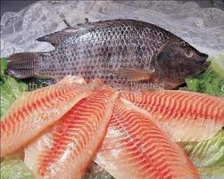
Thank you!

